Slide 1
Viral Marketing: Influential nodes
By Ujjawal Garg
Notes:
topic for my presentation

Slide 2
Problem Statement
Identify a set of nodes that can propagate ideas to the largest range on the network
Need some metric for ranking the nodes
1
Notes:
as well as in shortest time

Slide 3
Centrality
defines how central the node is in the network
can be used to measure the influence
2
Notes:
we have already seen some metrics
Let's quickly go over these

Slide 4
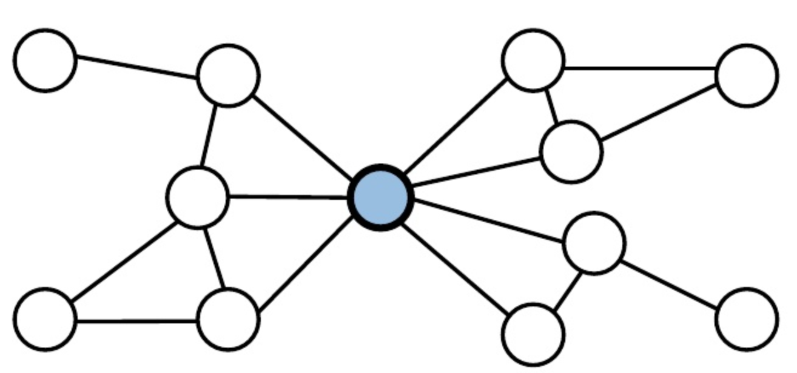
Degree Centrality
How connected the node is?
3

Slide 5
Degree Centrality
How connected the node is?
Measure only immediate
Influence, and misses the
bigger picture
3

Slide 6
Betweenness Centrality
How in-between the node is?
4

Slide 7
Betweenness Centrality
How in-between the node is?
Very high computational cost
4

Slide 8
Closeness Centrality
How reachable the node is?
5

Slide 9
Closeness Centrality
How reachable the node is?
Very high computational cost
5

Slide 10
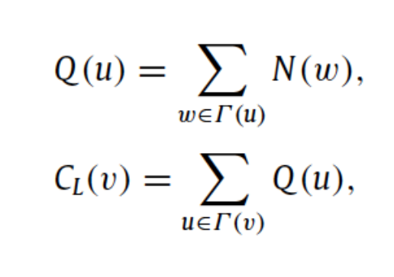
Local Centrality
Introduced by Chen et. al in 2012
trade-off between low-relevance and high computation cost
Local centrality C_{L}(v) is defined as:
Γ(u) is the set of the nearest neighbors
of node u
N(w) is the number of the nearest and
the next nearest neighbors
6
Notes:
Let's try to understand in terms of LinkedIn connections
Tau{U} is the 1st degree connections
N{W} is the total of 1st and 2nd degree connections

Slide 11
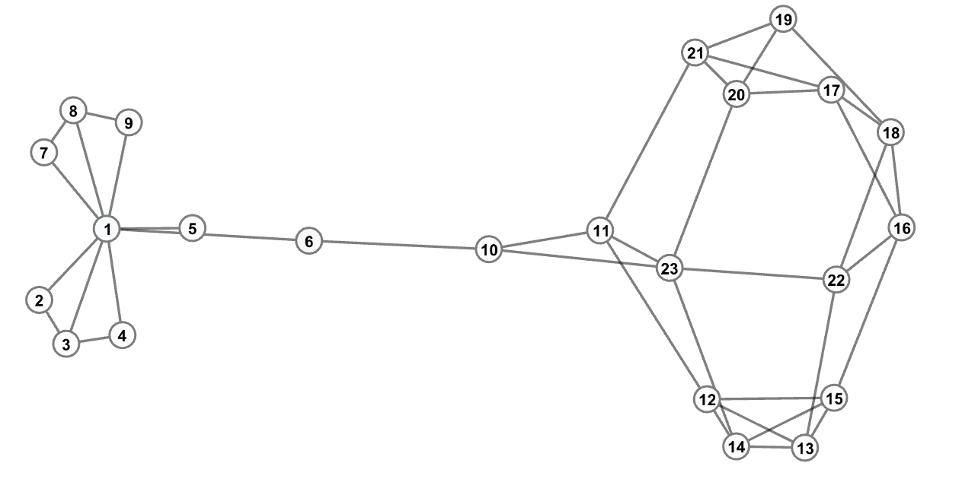
ExamPLE
Degree of Node 1 is Highest: 6
What’s the Local Centrality?
7
Notes:
Let's calculate the N-Values (sum of 1st and second)
For 1st node:
There are 8 1st degree connections, and 1 2nd degree, so total N(1) = 9

Slide 12
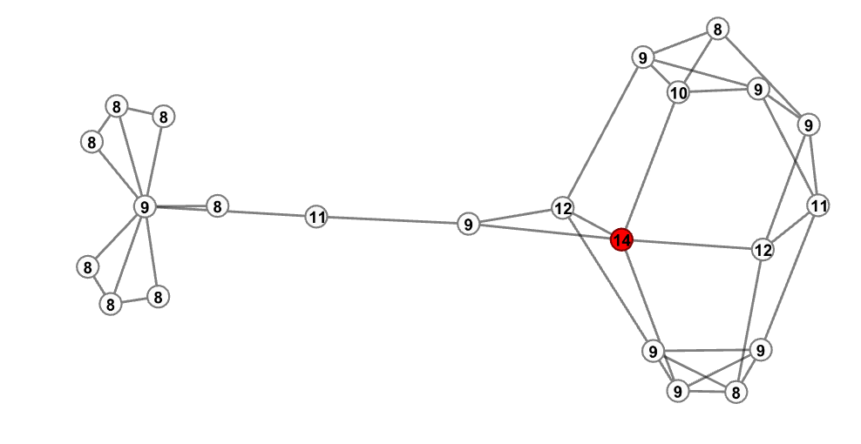
N-VALUES
N(w) is the number of the nearest and
the next nearest neighbors
8
Notes:
Here I am representing the N-values inside the node
Now, the Q-values would be sum of N-values over the neighborhood of the node.
For Node 1, this is 67

Slide 13
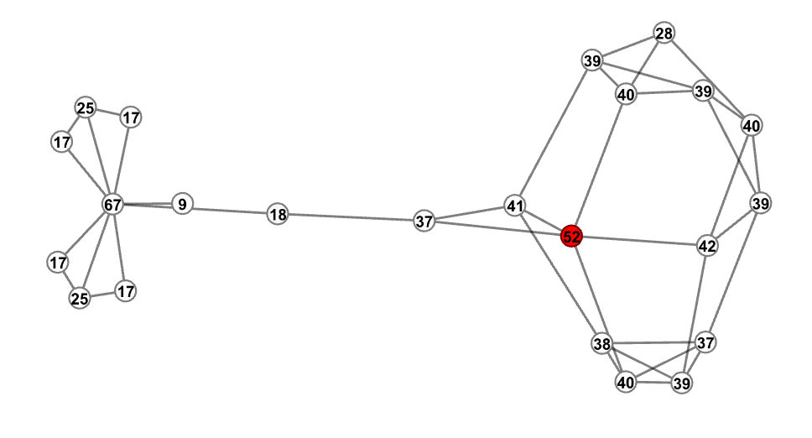
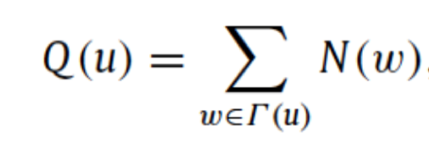
Q-VALUES
9
Notes:
Now for the C-values: we calculate the sum of Q-values over the neighborhood

Slide 14
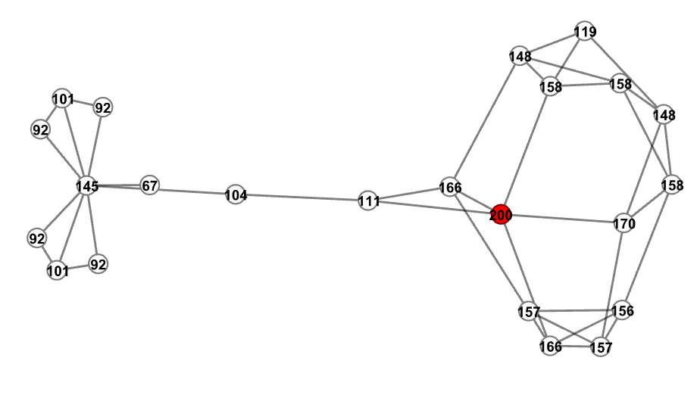
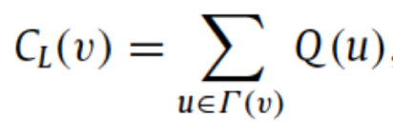
L-VALUES
10
Notes:
As you can see, in this metric degree of far away nodes are also taken into account, but the effect is discounted.

Slide 15
Complexity Analysis
Closeness: O(n³)
11

Slide 16
Complexity Analysis
Closeness: O(n³)
Betweenness: O(n²⟨k⟩), where k is average degree
11

Slide 17
Complexity Analysis
Closeness: O(n³)
Betweenness: O(n²⟨k⟩), where k is average degree
Local: O(n⟨k⟩²), where k is average degree
11

Slide 18
Complexity Analysis
Closeness: O(n³)
Betweenness: O(n²⟨k⟩), where k is average degree
Local: O(n⟨k⟩²), where k is average degree
Degree: O(1)
11

Slide 19
How to compare these?
SIR (Susceptible-Infected-Recovered) Model
12

Slide 20
How to compare these?
SIR (Susceptible-Infected-Recovered) Model
Each node can be in any of 3 states:
Susceptible: Not yet Infected
Infected: Will infect a randomly chosen neighbor at each time step
Recovered: Immune and will not take part in spreading infection
12

Slide 21
SIR Model
Infected nodes recover with probability 1/k, where k is average degree of the network
Influence measured by total number of INFECTED + RECOVERED nodes at time t, denoted by F(t)
13

Slide 22
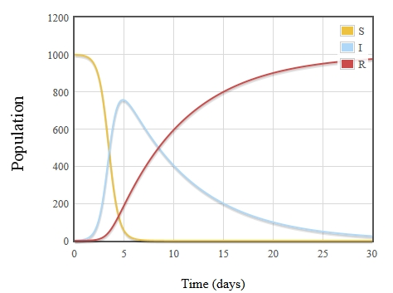
SIR Model
14

Slide 23
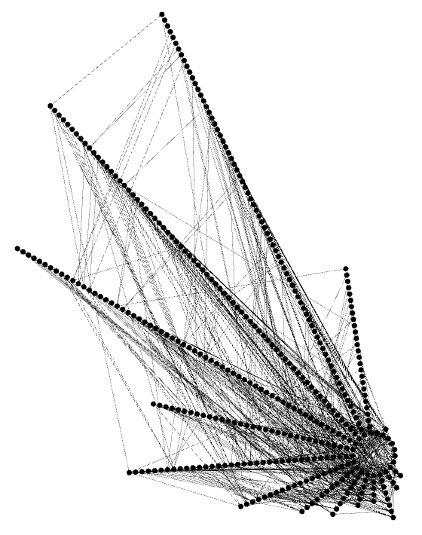
Data set 1
Netscience: a network of co-authorships between scientists
379 nodes
914 Edges
Avg. Degree : 4.82
Max degree : 34
Clustering Coeff. : 0.3706
15
Notes:
between members of University of Rovira

Slide 24
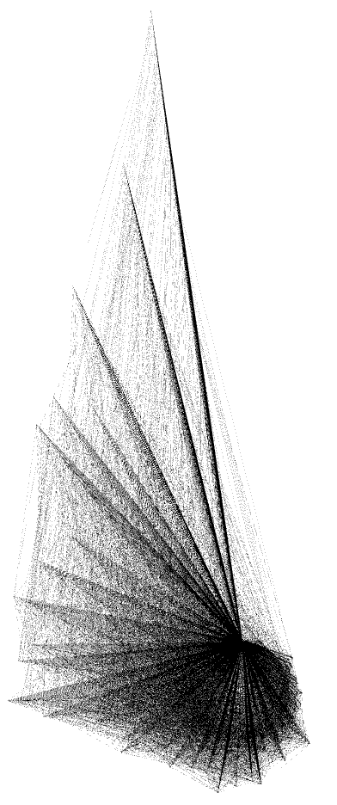
Data set 2
Email: a Network of e-mail interchanges
1133 nodes
5451 Edges
Avg. Degree : 9.62
Max degree : 71
Clustering Coeff. : 0.1101
16
Notes:
between members of University of Rovira

Slide 25
Results (Analysis) – Netscience Dataset
17

Slide 26
Results (Analysis) – Email Dataset
18

Slide 27
Thank you
19

Slide 28
References
[1] Ming-Sheng Shang Yi-Cheng Zhang Tao Zhou Duanbing Chen, Linyuan L. Identifying influential nodes in complex networks. 2012.
[2] R.M. Anderson, R.M. May, B. Anderson, Infectious Diseases of Humans: Dynamics and Control, Oxford University Press, USA, 1992.
[3] M. E. J. Newman, Finding community structure in networks using the eigenvectors of matrices, Preprint physics/0605087 (2006) Link: http://nrvis.com/download/data/ca/ca-netscience.zip
[4] R. Guimer., L. Danon, A. D.az-Guilera, F. Giralt, A. Arenas, Self-similar community structure in a network of human interactions, Phys. Rev. E 68 (2003) 065103. Link: http://deim.urv.cat/~aarenas/data/xarxes/email.zip
20

